Slide 1
MSP430
P.RAJESH
DEPT OF E.C.E
JNTUACEA

Slide 2
1.Introduction to MSP430
The MSP430 (Mixed Signal Processor ) was a board family of LowPower 16–bit microcontroller from Texas Instruments.
The MSP430 (Mixed Signal Processor ) was introduced in the late 1990s, although its ancestry goes back to the 4-bit TSS400.
It is a particularly straight forward 16-bit processor with a von Neumann architecture, designed for low-power applications.
Ultra low power optimization extends battery life and multiple low power modes of operation
The CPU is often described as a reduced instruction set computer (RISC) “Reflections on the CPU and Instruction Set.
Currently at least 40 flavors available

Slide 3
The family of devices ranges from
1k ROM – 60k ROM
128 bytes RAM – 2K RAM
Price : $ - $10
The device split into 3 families :
MSP430x3xx is a basic unit
MSP430x1xx is more feature rich family
MSP430x4xx is similar to 1xx with built in LCD driver

Slide 4
Part Numbering Convention
Part numbers for MSP430 devices are determined based on their capabilities.
All device part numbers follow the following template:
MSP430MtFaFbMc
Mt: Memory Type
C: ROM
F: Flash
P: OTP
E: EPROM (for developmental use. There are few of these.)
Mc: Memory Capacity
0: 1kb ROM, 128b RAM
1: 2kb ROM, 128b RAM
2: 4kb ROM, 256b RAM
3: 8kb ROM, 256b RAM
4: 12kb ROM, 512b RAM
5: 16kb ROM, 512b RAM
6: 24kb ROM, 1kb RAM
7: 32kb ROM, 1kb RAM
8: 48kb ROM, 2kb RAM
9: 60kb ROM, 2kb RAM
Fa, Fb: Family and Features
10, 11: Basic
12, 13: Hardware UART
14: Hardware UART, Hardware Multiplier
31, 32: LCD Controller
33: LCD Controller, Hardware UART, Hardware Multiplier
41: LCD Controller
43: LCD Controller, Hardware UART
44: LCD Controller, Hardware UART, Hardware Multiplier

Slide 5
Example:
MSP430F435
F- Flash memory device
43- LCD controller, a hardware UART,
5- as 16 kb of code memory, and 512 bytes of RAM.

Slide 6
2.Where Does MSP430 Fit
The MSP430 is the simplest microcontroller in TI’s current portfolio. Its more powerful siblings include the TMS470, which is based on the 32/16-bit ARM7, and the C2000, which incorporates a digital signal processor.
It supports both the address and data buses are 16-bits wide.
The registers in the CPU are also all 16 bits wide and can be used interchangeably for either data or addresses.
This makes the MSP430 simpler than an 8-bit processor with 16-bit addresses.
It can address 2¹⁶ = 64KB of memory.
MSP430X has extended register and wider address bus that handle up to 1MB of memory

Slide 7
In many ways, the MSP430 fits between traditional 8- bit and 16-bit processors.
The MSP430 has 16 registers in its CPU, which enhances efficiency because they can be used for local variables, parameters passed to subroutines, and either addresses or data.
Its more powerful siblings include the TMS470, which is based on the 32/16-bit ARM7, and the C2000, which incorporates a digital signal processor

Slide 8
2.1.Features make the MSP430 suitable for low-power :
The CPU is small and efficient, with a large number of registers.
Easy to put the device into a low-power mode: No special instruction is needed: The mode is controlled by bits in the status register.
The MSP430 is awakened by an interrupt and returns automatically to its low-power mode after handling the interrupt.
There are several low-power modes, depending on how much of the device should remain active and how quickly it should return to full-speed operation.

Slide 9
There is a wide choice of clocks: low-frequency watch crystal runs continuously at 32 KHz and is used to wake the device periodically.
The CPU is clocked by an internal, Digitally Controlled oscillator (DCO), which restarts in less than 1s in the latest devices.
Therefore the MSP430 can wake from a standby mode rapidly, perform its tasks, and return to a low-power mode.
A wide range of peripherals is available, many of which can run autonomously without the CPU for most of the time.
Many portable devices include liquid crystal displays, which the MSP430 can drive directly.
Some MSP430 devices are classed as application-specific standard products (ASSPs) and contain specialized analog hardware for various types of measurement.

Slide 10
Currently 4 – Families of MSP430 available letter after MSP430 shows type of memory
F- FLASH
C – ROM
For ASSPs type of measurements intended
E – Electricity
W- for Water
G – for Signal that require gain provided by operational Amplifier
a ) MSP430x1xx:
Provides a wide range of general-purpose devices from simple versions to complete systems for processing signals.
Peripherals include a hardware multiplier, which can be used as a rudimentary digital signal processor.
Packages have 20–64 pins.

Slide 11
MSP430F2xx:
A newer, general-purpose family introduced in 2005.
Its CPU can run at 16 MHz, double the speed of earlier devices, while consuming only half the current at the same speed.
Some come in 14-pin packages, including a traditional plastic dual-in-line (PDIP)
Package is – 14pin requires low frequency clock
Pull-up or pull-down resistors are provided on the inputs to reduce the number of external components needed. There are many options for analog inputs. Even the smallest, 14-pin devices offer a 16-bit sigma–delta ADC.

Slide 12
MSP430x3xx: The original family, which includes drivers for LCDs.
MSP430x4xx: Can drive LCDs with up to 160 segments. Many of them are ASSPs, but there are general-purpose devices as well.
Their packages have 48–113 pins, many of which are needed for the LCD.
MSP430X: The original MSP430 architecture, extended to give the MSP430X in 2006, mainly so that it can address extra memory but with other improvements as well.
The devices are included in the MSP430F2xx and MSP430F4xx families with nothing in their part number to distinguish them.
The CPU is a MSP430x if there is more than 64KB of memory.

Slide 13
3.Architecture: CPU and Memory
The MSP430 utilizes a 16-bit RISC architecture, which is capable of processing instructions on either bytes or words.
The ’430 family. It consists of a 3-stage instruction pipeline, instruction decoding, a 16-bit ALU, four dedicated-use registers, and twelve working (or scratchpad) registers.
The CPU is connected to its memory through two 16-bit busses, one for addressing, and the other for data.
All memory, including RAM, ROM, information memory, special function registers, and peripheral registers are mapped into a single, contiguous address space

Slide 14
CPU Features
The ALU
The ’430 processor includes a pretty typical ALU (arithmetic logic unit). The ALU handles addition, subtraction, comparison and logical (AND, OR, XOR) operations. ALU operations can affect the overflow, zero, negative, and carry flags.
Working Registers
12 working register of 16-bit ( R14- R15) used for register mode operation.
Any variable which is accessed often should reside in one of these locations, for the sake of efficiency.
Any of these registers for any purpose, either data or address.
R4 and R5 reserve for debug information.
R8, R9, R15 used for code extensive operations

Slide 15
Constant Generators
R2 and R3 function as constant generators,
so that register mode may be used instead of immediate mode for some common constants. (R2 is a dual use register. It serves as the Status Register, as well.)
Generated constants include some common single-bit values (0001h, 0002h, 0004h, and 0008h), zero (0000h), and an all 1s field (0FFFFh). Generation is based on the W(S) value in the instruction word, and is described by the table below.
W(S) | Value in R2 | Value in R3
00 | - | 0000h
01 | 0 (obsolute mode ) | 0001h
10 | 0004h | 0002h
11 | 0008h | 0ffffh

Slide 16
Program Counter
The Program Counter is located in R0. Since individual memory location addresses are 8-bit, but all instructions are 16 bit, the PC is constrained to even numbers (i.e. the LSB of the PC is always zero).
One exception to this rule of thumb is the implementation of a switch, where the code jumps to a spot, dependent on a given value. (I.e., if value=0, jump to location0,
if value=1, jump to location1, etc.)

Slide 17
Status Register
The Status Register is implemented in R2, and is comprised of various system flags.
The flags are all directly accessible by code, and all but three of them are changed automatically by the processor itself. The 7 most significant bits are undefined. The bits of the SR are:

Slide 18
The Carry Flag (C)
Location: SR(0) (the LSB)
Function: Identifies when an operation results in a carry. Can be set or cleared by software, or automatically.
1=Carry occurred
0=No carry occurred
The Zero Flag (Z)
Location: SR(1)
Function: Identifies when an operation results in a zero. Can be set or cleared by software, or automatically.
1=Zero result occurred
0=Nonzero result occurred

Slide 19
The Negative Flag (N)
Location: SR(2)
Function: Identifies when an operation results in a negative. Can be set or cleared by software, or automatically. This flag reflects the value of the MSB of the operation result (Bit 7 for byte operations, and bit 15 for word operations).
1=Negative result occurred
0=Positive result occurred
The Global Interrupt Enable (GIE)
Location: SR(3)
Function: Enables or disables all maskable interrupts. Can be set or cleared by software, or automatically. Interrupts automatically reset this bit, and the retie instruction automatically sets it.
1=Interrupts Enabled
0=Interrupts Disabled

Slide 20
The CPU off bit (CPUOff)
Location: SR(4)
Function: Enables or disables the CPU core. Can be cleared by software, and is reset by enabled interrupts. None of the memory, peripherals, or clocks are affected by this bit. This bit is used as a power saving feature.
1=CPU is on
0=CPU is off
The Oscillator off bit (OSCOff)
Location: SR(5)
Function: Enables or disables the crystal oscillator circuit. Can be cleared by software, and is reset by enabled external interrupts.
OSCOff shuts down everything, including peripherals. RAM and register contents are preserved. This bit is used as a power saving feature.
1=LFXT1 is on
0=LFXT1 is off

Slide 21
The System Clock Generator (SCG1,SCG0)
Location: SR(7),SR(6)
Function: These bits, along with OSCOff and CPUOff define the power mode of the device.
The Overflow Flag (V)
Location: SR(8)
Function: Identifies when an operation results in an overflow. Can be set or cleared by software, or automatically. Overflow occurs when two positive numbers are added together, and the result is negative, or when two negative numbers are added together, and the result is positive. The subtraction definition of overflow can be derived from the additive definition.
1=Overflow result occurred
0=No overflow result occurred

Slide 22
Stack Pointer
The Stack Pointer is implemented in R1. Like the Program Counter.
The LSB is fixed as a zero value, so the value is always even.
The stack is implemented in RAM, and it is common practice to start the SP at the top (highest valid value) of RAM.
The push command moves the SP down one word in RAM (SP=SP-2), and puts the value to be pushed at the new SP. Pop does the reverse.
Call statements and interrupts push the PC, and return statements pop the value from the TOS (top of stack) back into the PC.

Slide 23
4.Key Features of MSP430
with a set of intelligent peripherals like I/O, Timers ADC, DAC, flexible clock and USCI
low cost
lowest power consumption
Ultra low power optimization extends battery life
multiple low power modes of operation

Slide 24
Extensive interrupt capability relieves need for polling
Prioritized nested interrupts
Seven source-addressing modes
Four destination-addressing modes
Only 27 core instructions and
24 Emulated Instructions
Large register file
Efficient table processing
Fast hex-to-decimal conversion

Slide 25
MSP430 requires
0.1 μ A for RAM data Retention,
0.8 μ A for RTC mode operation
250 μA /MIPS for active mode operation.
• Low operation voltage (from 1.8 V to 3.6 V).
• Zero-power Brown-Out -Reset (BOR)

Slide 26
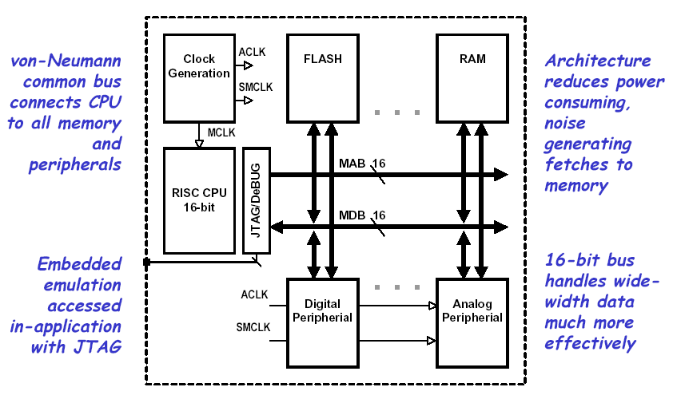
5.Architecture - MSP430

Slide 27
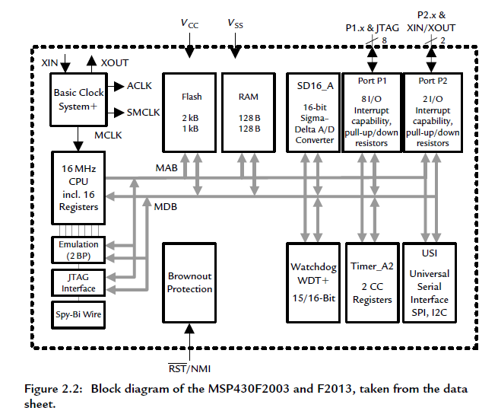

Slide 28
On the left is the CPU and its supporting hardware, including the clock generator.
The emulation, JTAG interface and Spy-Bi-Wire are used to communicate with a desktop computer when downloading a program and for debugging.
lower voltages and a range of 1.8–3.6V is specified for the F2013.

Slide 29
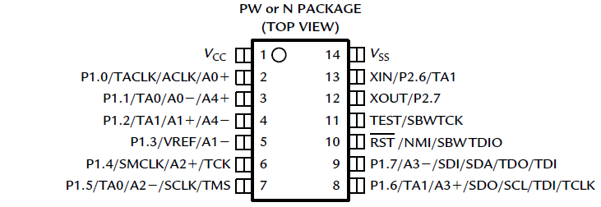
5.1.Pin-Out
The MSP430F2013 is available in a traditional 14-pin plastic dual-in-line package (PDIP) with pins 0.1

Slide 30
VCC and VSS are the supply voltage and ground for the whole device (the analog and digital supplies are separate in the 16-pin package).
P1.0–P1.7, P2.6, and P2.7 are for digital input and output, grouped into ports P1 and P2.
• TACLK, TA0, and TA1 are associated with Timer A; TACLK can be used as the clock input to the timer, while TA0 and TA1 can be either inputs or outputs. These can be used on several pins because of the importance of the timer

Slide 31
A0−, A0+, and so on, up to A4±, are inputs to the analog-to-digital converter. It has four differential channels, each of which has negative and positive inputs.
VREF is the reference voltage for the converter.
• ACLK (Auxiliary Clk) and SMCLK ( Sub Main CLK) are outputs for the microcontroller’s clock signals. These can be used to supply a clock to external components or for diagnostic purposes.
• SCLK (serial Clk) , SDO (Serial Data ), and SCL (serial Control) are used for the universal serial interface, which communicates with external devices using the serial peripheral interface (SPI) or inter-integrated circuit (I2C) bus.

Slide 32
XIN and XOUT are the connections for a crystal, which can be used to provide an accurate, stable clock frequency.
RST is an active low reset signal. Active low means that it remains high near VCC for normal operation and is brought low near VSS to reset the chip. Alternative notations to show the active low nature are _RST and /RST.
NMI is the non maskable interrupt input, which allows an external signal to interrupt the normal operation of the program.
TMS (Test Master/slave) , TCLK, TDI(Test Data input), TDO(Test Data output), and TEST form the full JTAG interface, used to program and debug the device.

Slide 33
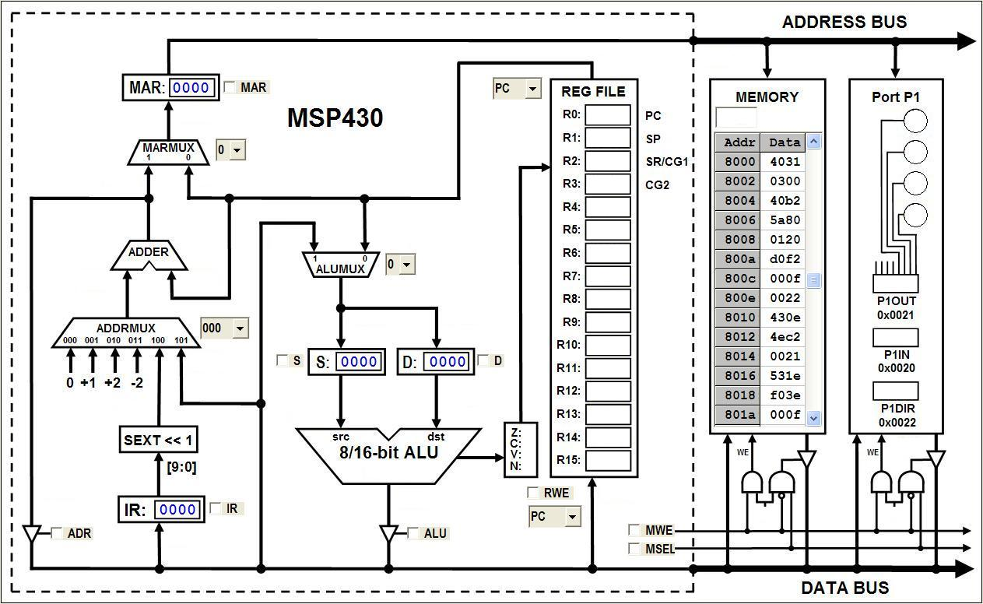
Memory Address Register
Program Counter
Source Operand
Instruction Register
Destination Operand
Port 1 Output
Arithmetic Logic Unit
Memory
Condition Codes

Slide 34
5.2.MSP430 CPU Registers
The CPU of MSP 430 includes a 16-bit ALU and a set of 16 Registers R0 –R15.
In these registers 4 are special Purpose and 12 are general purpose registers .
The special Purpose Registers are
PC (Program Counter),
SP (Stack Pointer) ,
SR (Status Register) and
CGx (Constant Generator)

Slide 35
Registers
R0 /PC | Program Counter
R1/SP | Stack Pointer
R2/SR/CG1 | Status Register
R3/CG2 | Constant Generator
R4 | General Purpose register
R5 | General Purpose register
:
R15 | General Purpose register

Slide 36
6.The Instruction Cycle
INSTRUCTION FETCH
Obtain the next instruction from memory
DECODE
Examine the instruction, and determine how to execute it
SOURCE OPERAND FETCH
Load source operand
DESTINATION OPERAND FETCH
Load destination operand
EXECUTE
Carry out the execution of the instruction
STORE RESULT
Store the result in the designated destination
Not all instructions require all six phases

Slide 37
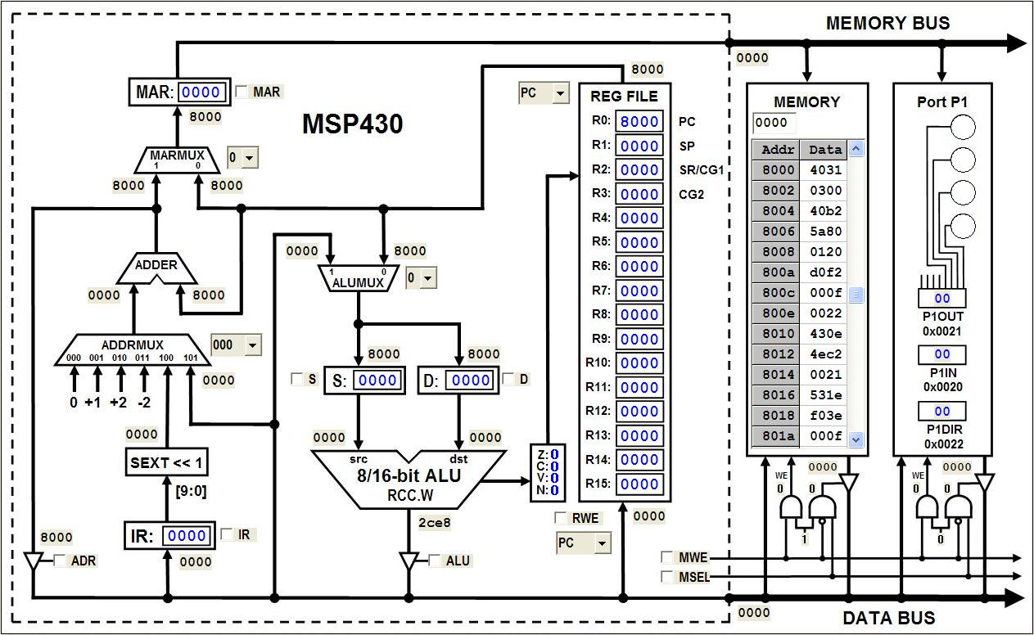
Fetching an Instruction
PC can be incremented anytime during the Fetch phase
PC
❶
❷

Slide 38
Source Addressing Modes
The MSP430 has four basic modes for the source address:
Rs - Register
x(Rs) - Indexed Register
@Rs - Register Indirect
@Rs+ - Indirect Auto-increment
In combination with registers R0-R3, three additional source addressing modes are available:
label - PC Relative, x(PC)
&label – Absolute, x(SR)
#n – Immediate, @PC+

Slide 39
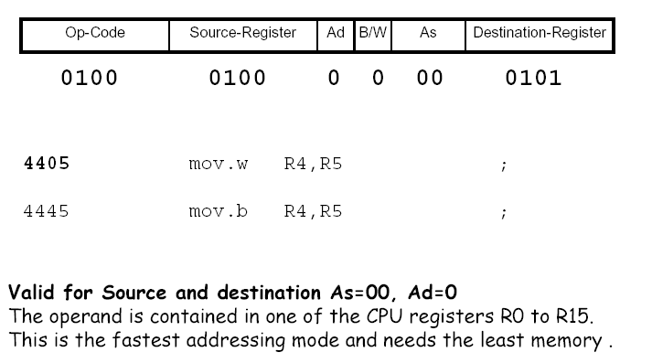
Register Addressing Mode
Register mode operations work directly on the processor registers, R4 through R15, or on special function registers, such as the program counter or status register.
They are very efficient in terms of both instruction speed and code space.
Ex : MOV R4, R5
Move (copy) the contents of source (register R4) to destination (register R5). Register R4 is not affected.

Slide 40
The PC is incremented by 2 while the instruction is being fetched, before it is used as a source.
• The constant generator CG2 reads 0 as a source.
• Both PC and SP must be even because they address only words, so the lsb is discarded if they are used as the destination.
For byte instructions,
• Operands are taken from the lower byte; the upper byte is not affected.
• The result is written to the lower byte of the register and the upper byte is cleared.

Slide 41
Source: Indexed Register Mode – Rs
Select the generic source register
Rs
❶

Slide 42
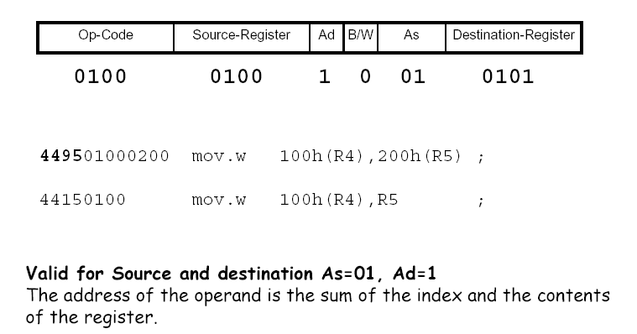
Register-Indexed Addressing Mode

Slide 43
The Indexed mode commands are formatted as X(Rs), where X is a constant and Rn is one of the CPU registers.
The absolute memory location X+Rs is addressed.
Indexed mode addressing is useful for applications such as lookup tables
Ex : MOV F000h(R5), R4
Move (copy) the contents at source address (F000h +R5) to destination (register R4)

Slide 44
Source: Indexed Mode – x(Rs)
PC incremented at end of phase
❶
PC
PC
Rs
Use PC to obtain index, use Rs for base register
❹
❷
❸

Slide 45
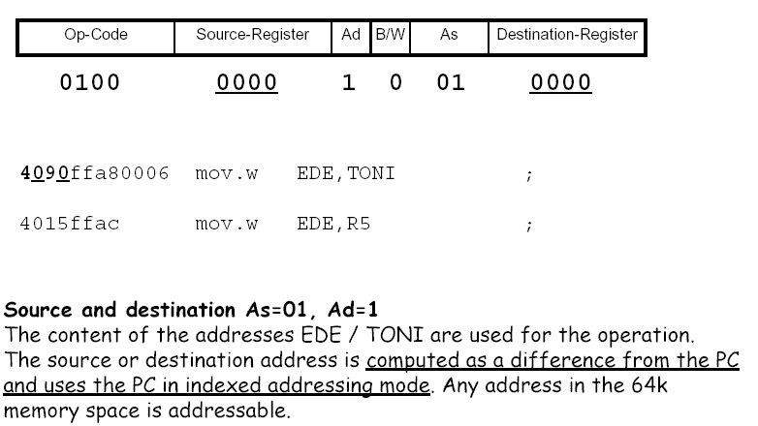
Symbolic Addressing Mode

Slide 46
Symbolic mode allows the assignment of labels to fixed memory locations, so that those locations can be addressed. This is useful for the development of embedded programs.
MOV XPT, YPT
Move the content of source address XPT (x pointer) to the destination address YPT (y pointer).
Eg:-
The following instruction stores the value of LoopCtr in R6 using symbolic mode:
mov.w LoopCtr ,R6 ; load word LoopCtr into R6 , symbolic mode
The assembler replaces this by the indexed form
mov.w X(PC),R6 ; load word LoopCtr into R6 , symbolic mode
where X = LoopCtr − PC is the offset that needs to be added to PC to get the address of LoopCtr. This calculation is performed by the assembler, which also accounts for the automatic incrementing of PC.

Slide 47
Source: Symbolic Mode – Address
PC incremented at end of phase
❶
PC
PC
PC
Use PC to obtain relative index and for base register
❹
❷
❸

Slide 48
Absolute Addressing mode
Similar to Symbolic mode, with the difference that the label is preceded by “&”.
The word following the instruction contains the absolute address. X is stored in the next word. Indexed mode X(SR) is used
MOV &XPT, &YPT
Move the content of source address XPT to the destination address YPT.
This example copies the port 1 input register into register R6:
mov.b &P1IN ,R6 ; load byte P1IN into R6 , absolute mode
The assembler replaces this by the indexed form
mov.b P1IN(SR),R6 ; load byte P1IN into R6 , absolute mode
where P1IN is the absolute address of the register.

Slide 49
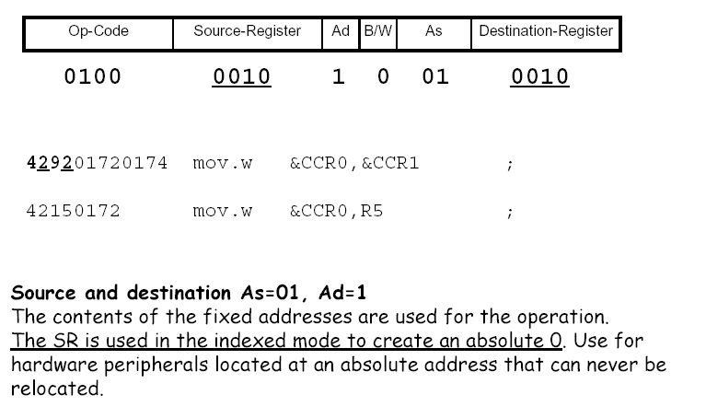
Absolute Addressing Mode

Slide 50
Source: Absolute Mode – &Address
PC can be incremented anytime during the phase
❶
PC
#0
Use PC to obtain absolute address, use #0 for base register
❷
❸

Slide 51
Indirect Register Addressing mode
The data word addressed is located in the memory location pointed to by Rn.
Indirect mode is not valid for destination operands, but can be emulated with the indexed mode format @(Rn). Here Rn is used as a pointer to the operand.
MOV @(R4), R5
Move the contents of the source address (contents of R4) to the destination (register R5). Register R4 is not modified

Slide 52
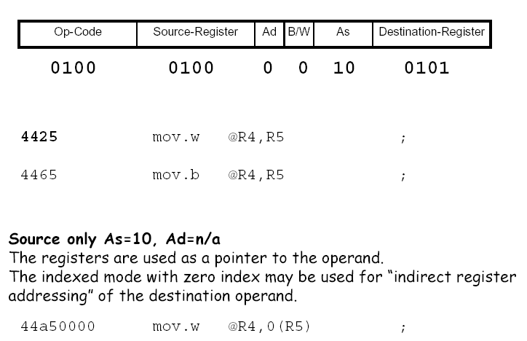
Register Indirect Addressing Mode

Slide 53
Source: Indirect Mode – @Rs
❶
Rs
❷

Slide 54
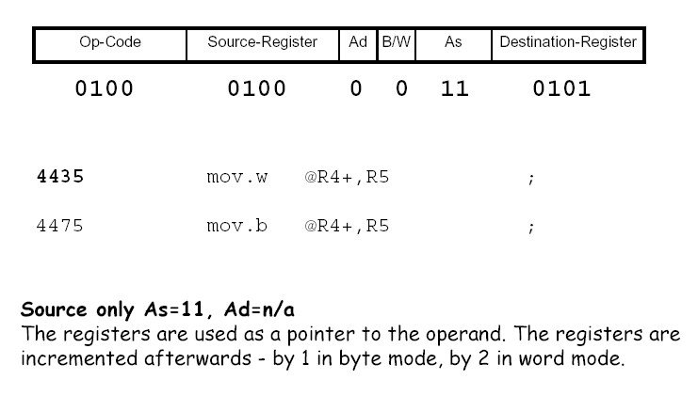
Register Indirect Auto-increment

Slide 55
Register Indirect Auto-increment
It uses the value in R5 as a pointer and automatically increments it afterward by 1 if a byte has been fetched or by 2 for a word. Suppose yet again that R5 contains the value 4 before this instruction:
mov.w @R5+,R6
A word is loaded from address 4 into R6 and the value in R5 is incremented to 6 because a word (2 bytes) was fetched

Slide 56
Source: Indirect Auto Mode – @Rs+
❶
Rs
Increment by 1 (.b) or 2 (.w)
❷

Slide 57
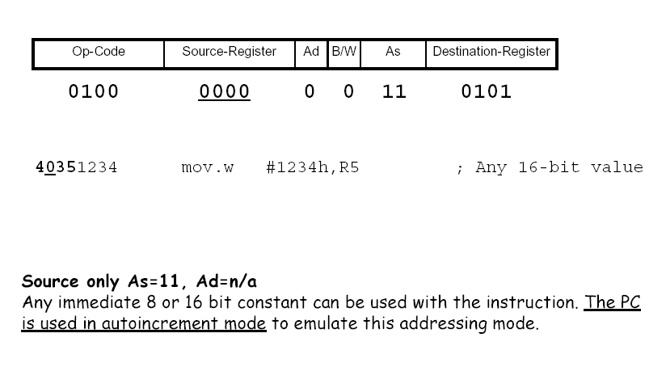
Immediate Addressing Mode
mov.w @PC+,R6 ; load immediate word into R6

Slide 58
Source: Immediate Mode – #n
PC can be incremented anytime during the phase
❶
PC
❷

Slide 59
MSP430 Source Constants
To improve code efficiency, the MSP430 "hardwires" six register/addressing mode combinations to commonly used source values:
#0 - R3 in register mode
#1 - R3 in indexed mode
#4 - R2 in indirect mode
#2 - R3 in indirect mode
#8 - R2 in indirect auto-increment mode
#-1 - R3 in indirect auto-increment mode
Eliminates the need to use a memory location for the immediate value - commonly reduces code size by 30%.

Slide 60
Source: Constant Mode – #1 (-1,0,1,2,4,8)
R3
❶

Slide 61
Destination Addressing Modes
There are two basic modes for the destination address:
Rd - Register
x(Rd) - Indexed Register
In combination with registers R0/R2, two additional destination addressing modes are available:
label - PC Relative, x(PC)
&label – Absolute, x(SR)

Slide 62
Destination: Register Mode – Rd
Rd
❶

Slide 63
Destination: Indexed Mode – x(Rd)
PC incremented at end of phase
❶
PC
PC
Rs
Use PC to obtain index, use Rs for base register
❹
❷
❸

Slide 64
Destination: Absolute Mode – &Address
PC can be incremented anytime during the phase
❶
PC
#0
Use PC to obtain absolute address, use #0 for base register
❷
❸

Slide 65
Destination: Symbolic Mode – Address
PC incremented at end of phase
❶
PC
PC
PC
Use PC to obtain relative index and for base register
❹
❷
❸

Slide 66
Addressing modes Examples :
Register Mode :
Example 1: Move (copy) the contents of source (register R4) to destination (register R5). Register R4 is not affected.
Before operation: R4=A002h R5=F50Ah PC = PCpos
Operation: MOV R4, R5
After operation: R4=A002h R5=A002h PC = PCpos + 2
2. Indexed mode
Example 2: Move (copy) the contents at source address (F000h + R5) to destination (register R4).
Before operation: R4=A002h R5=050Ah Loc:0xF50A=0123h
Operation: MOV F000h(R5), R4
After operation: R4=0123h R5=050Ah Loc:0xF50A=0123h

Slide 67
3. Symbolic mode :
Example 3: Move the content of source address XPT (x pointer) to the destination address YPT (y pointer).
Before operation: XPT=A002h Location YPT=050Ah
Operation: MOV XPT, YPT
After operation: XPT= A002h Location YPT=A002h
4. Absolute mode
Example 4: Move the content of source address XPT to the destination address YPT.
Before operation: Location XPT=A002h Location YPT=050Ah
Operation: MOV &XPT, &YPT
After operation: Location XPT= A002h Location YPT=A002h

Slide 68
5. Indirect register mode
Example 5: Move the contents of the source address (contents of R4) to the destination (register R5). Register R4 is not modified.
Before operation: R4=A002h R5=050Ah Loc:0xA002=0123h
Operation: MOV @(R4), R5
After operation: R4= A002h R5=0123h Loc:0xA002=0123h
6. Indirect auto increment mode
Example 6: Move the contents of the source address (contents of R4) to the destination (register R5), then increment the value in register R4 to point to the next word.
Before operation: R4=A002h R5=050Ah Loc:0xA002=0123h
Operation: MOV @R4+, R5
After operation: R4= A004h R5=0123h Loc:0xA002=0123h

Slide 69
7. Immediate mode
Example 7: Move the immediate constant E2h to the destination (register R5).
Before operation: R4=A002h R5=050Ah
Operation: MOV #E2h, R5
After operation: R4= A002h R5=00E2h

Slide 70
Final Instruction Phases
Execute
PUSH
Decrement stack pointer (R1)
Ready address for store phase
JUMP
Compute 10-bit, 2’s complement, sign extended
Add to program counter (R0)
Store
Move data from ALU to register, memory, or I/O port

Slide 71
Execute Phase: PUSH.W
SP = SP - 2
SP
❶
Use Store Phase to push on stack

Slide 72
Execute Phase: Jump
PC
2’s complement, sign-extended
Select “COND” to conditionally change PC
❶

Slide 73
Store Phase: Rd
❶

Slide 74
Store Phase: Other…
❶

Slide 75
Instruction set
The MSP430 instruction set consists of 27 core instructions. Additionally, it supports 24 emulated instructions. The core instructions have unique op-codes decoded by the CPU, while the emulated ones need assemblers and compilers to generate their mnemonics.
There are three core-instruction formats:
❑ Double operand;
❑ Single operand;
❑ Program flow control - Jump.
Byte, word and address instructions are accessed using the .B, .W or .A extensions.

Slide 76
Instruction Timing
Instruction cycles = Power consumption
Most instruction cycles limited by access to memory (von Neumann bottleneck)
In general
1 cycle to fetch instruction
+1 cycle for @Rn, @Rn+, or immediate
+2 cycles for indexed, absolute, or symbolic
+1 to write destination back to memory
2 cycles for any jump
No difference between byte and word

Slide 77
Cycles Per Instruction...
Instruction timing:
1 cycle to fetch instruction word
+1 cycle if source is @Rn, @Rn+, or #Imm
+2 cycles if source uses indexed mode
1st to fetch base address
2nd to fetch source
Includes absolute and symbolic modes
+2 cycles if destination uses indexed mode
+1 cycle if writing destination back to memory

Slide 78
Mnemonic Operation Description
Arithmetic instructions
ADD(.B or .W) src,dst src+dst→dst //Add source to destination
ADDC(.B or .W) src,dst src+dst+C→dst //Add source and carry to destination
DADD(.B or .W) src,dst src+dst+C→dst (dec) //Decimal add source and carry to destination
SUB(.B or .W) src,dst dst+.not.src+1→dst //Subtract source from destination
SUBC(.B or .W) src,dst dst+.not.src+C→dst //Subtract source and not carry from destination

Slide 79
Logical and register control instructions
AND(.B or .W) src,dst src.and.dst→dst //AND source with destination
BIC(.B or .W) src,dst .not.src.and.dst→dst //Clear bits in destination
BIS(.B or .W) src,dst src.or.dst→dst //Set bits in destination
BIT(.B or .W) src,dst src.and.dst //Test bits in destination
XOR(.B or .W) src,dst src.xor.dst→dst //XOR source with destination

Slide 80
Data instructions
CMP(.B or .W) src,dst dst-src Compare source to destination
MOV(.B or .W) src,dst src→dst Move source to destination

Slide 81
Digital I/O
Digital I/O grouped in 8 bit memory locations called ports
Each I/O port can be:
programmed independently for each bit
combined for input, output, and interrupt functionality
Edge-selectable input interrupt capability for all 8 bits of ports P1 and P2
Read/write access using regular MSP430 byte instructions
Individually programmable pull-up/pull-down resistors
The available digital I/O pins for the hardware development tools:
eZ430-F2013: 10 pins - P1 (8 bits) and P2 (2 bits);
eZ430-F2274: 32 pins – P1, P2, P3, and P4

Slide 82
8-bit Digital I/O Registers
Direction Register (PxDIR):
Bit = 1: the individual port pin is set as an output
Bit = 0: the individual port pin is set as an input
Input Register (PxIN):
When pins are configured as GPIO, each bit of these read-only registers reflects the input signal at the corresponding I/O pin
Bit = 1: The input is high
Bit = 0: The input is low
Output Register (PxOUT):
Each bit of these registers reflects the value written to the corresponding output pin.
Bit = 1: The output is high;
Bit = 0: The output is low.
Note: the PxOUT is a read-write register which means previously written values can be read, modified, and written back

Slide 83
Select Digital I/O Registers
Function Select Registers: (PxSEL) and (PxSEL2):
PxSEL | PxSEL2 | Pin Function
0 | 0 | Selects general purpose I/O function
0 | 1 | Selects the primary peripheral module function
1 | 0 | Reserved (See device-specific data sheet)
1 | 1 | Selects the secondary peripheral module function
Port P2.0 Example:
P2SEL.0 | ADC10AE0.0 | Pin Function
0 | 0 | General-purpose digital I/O pin
1 | 0 | ACLK output
X | 1 | ADC10, analog input A0 / OA0, analog input I0

Slide 84
Interrupt Digital I/O Registers
Interrupt Enable (PxIE):
Read-write register to enable interrupts on individual pins on ports P1/P2
Bit = 1: The interrupt is enabled
Bit = 0: The interrupt is disabled
Each PxIE bit enables the interrupt request associated with the corresponding PxIFG interrupt flag
Interrupt Edge Select Registers (PxIES):
Selects the transition on which an interrupt occurs
Bit = 1: Interrupt flag is set on a high-to-low transition
Bit = 0: Interrupt flag is set on a low-to-high transition
Interrupt Flag Registers (PxIFG)
Set automatically when the programmed signal transition (edge) occurs
PxIFG flag can be set and must be reset by software
Bit = 0: No interrupt is pending
Bit = 1: An interrupt is pending

Slide 85
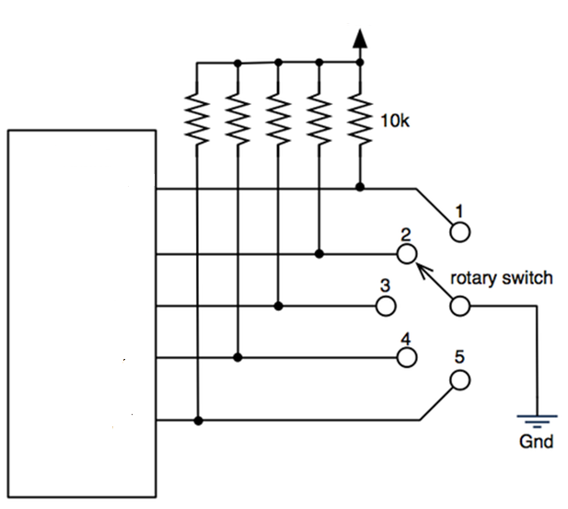
Pull-up/down Register
Digital I/O
Pull-up/down Resistor Enable Registers (PxREN):
Each bit of this register enables or disables the pull-up/pull-down resistor of the corresponding I/O pin
Bit = 1: Pull-up/pull-down resistor enabled
Bit = 0: Pull-up/pull-down resistor disabled.
When pull-up/pull-down resistor is enabled, Output Register (PxOUT) selects:
Bit = 1: The pin is pulled up
Bit = 0: The pin is pulled down.
+3.3v
P2.0
P2.1
P2.2
P2.3
P2.4

Slide 86
Port P1 Registers
Register Name | Short Form | Address | Register Type | Initial State
Input | P1IN | 020h | Read only | −
Output | P1OUT | 021h | Read/write | Unchanged
Direction | P1DIR | 022h | Read/write | Reset with PUC
Interrupt Flag | P1IFG | 023h | Read/write | Reset with PUC
Interrupt Edge Select | P1IES | 024h | Read/write | Unchanged
Interrupt Enable | P1IE | 025h | Read/write | Reset with PUC
Port Select | P1SEL | 026h | Read/write | Reset with PUC
Port Select 2 | P1SEL2 | 041h | Read/write | Reset with PUC
Resistor Enable | P1REN | 027h | Read/write | Reset with PUC

Slide 87
Core Instructions
1. ADD (.B or .W) src,dest // Add source to destination
Description: The source operand is added to the destination operand, and the result is placed in the destination. The value in source is preserved.
Operation: dest = dest + source
Opcode Structure:
R(S): Source Register (0 if not register operation)
W(D): 1=Destination word (index, symbolic, or absolute)
: 0=No destination word (register mode)
B/W: 1=Byte Instruction
0=Word Instruction

Slide 88
W(S): 00=No source word (register mode)
01=Index, symbolic, or absolute mode for source
10=Indirect register mode
11=Indirect autoincrement or immediate mode
R(D): Destination Register (0 if not register operation)
Example :
ADD #3Ah,R15 ; Add the value 3A to R15
ADD R15,&MAC ; Add the value in R15 to multiplier SFR(Special function Register)
// MAC – Multiply and Accumulate
ADD @R4,R7 ; Add the contents of the location pointed to by R4 to R7
JC FOO ; If carry flag is set by operation, jump to FOO
// FOO (or) BAR is a metasyntactic variable in programming uses Functions or Commands from Libraries (Place a Holder name)

Slide 89
2. ADDC (.B or .W) src,dest //Add source and carry to destination
Description: The source operand and carry flag are added to the destination operand, and the result is placed in the destination. The value in source is preserved.
Operation: dest = dest + source + C
Examples:
ADDC #3Ah,R15 ; Add the value 3A to R15
ADDC R15,&MAC ; Add the value in R15 to multiplier SFR
ADDC @R4,R7 ; Add the contents of the location pointed to by R4 to R7

Slide 90

3. AND (.B or .W) src,dest //Logical AND bits in source and destination
Operation: dest = dest AND src
Status Flags: Z: Set if result=0, reset otherwise
C: NOT Z N: Takes value of result MSB
V: Reset
Examples:
AND @R4,R7 ; AND the contents of the location pointed to by R4 to R7
AND #00FFh,R12 ; Mask off the top byte of R12

Slide 91
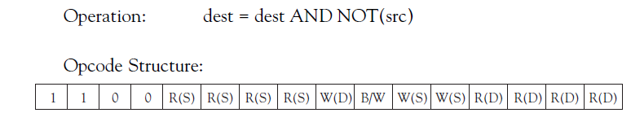
4. BIC (.B or .W) src,dest // Clear selected bits in destination
Description: Specific bits in the destination, as determined by the set bits in the source, are cleared. The value in source is preserved.
Operation: dest = dest AND NOT(src)
Status Flags: Status flags are unaffected by this operation.
Examples:
BIC #0030h,&TACTL ; Stop timer A (absolute)
BIC #00FFh,R12 ; Mask off the top byte of R12

Slide 92

5. BIS (.B or .W) src,dest //Set selected bits in destination
Description: Specific bits in the destination, as determined by the set bits in the source, are set. The value in source is preserved.
Operation: dest = dest OR src
Status Flags: Status flags are unaffected by this operation.
Examples:
BIS #0030h,&TACTL ; Start timer A in up/down mode
BIS #00FFh,R7 ; Set the low byte of R7

Slide 93

6. BIT (.B or .W) src,dest //Test selected bits in destination
Description: Specific bits in the destination, as determined by the set bits in the source, are tested. The values in source and destination are both preserved. This operation and the AND operation affect flags identically.
Operation: dest AND src
Status Flags: Z: Set if result=0, reset otherwise
C: NOT Z N: Takes value of result MSB V: Reset
Example:
BIT #0040h,R12 ; is bit 6 of R12 set?
JZ FOO ; If yes, jump to label FOO

Slide 94
7. CALL dest // Subroutine call
Description: A subroutine call is made to destination, and the current program counter is pushed to the stack. Destination can be anywhere in the 64k memory space.
Operation: PUSH PC
PC = dest
B/W: 0=Word Instruction (no byte mode for this operation)
W(S): 00=No source word (register mode)
01=Index, symbolic, or absolute mode for source
10=Indirect register mode 11=Indirect auto increment or immediate mode
R(D): Destination Register (0 if not register operation)

Slide 95
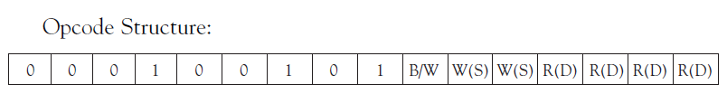
Status Flags: Status flags are unaffected by this operation.
Example:
CALL @R7 ; Call to address in word pointed to by R7
CALL #FOO ; Call to label FOO

Slide 96
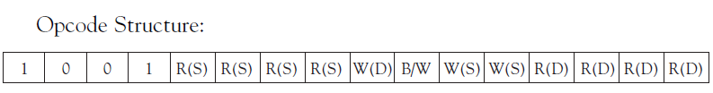
8. CMP (.B or .W) src,dest //Compare source to destination
Description: The source is subtracted from the destination. The values in source and destination are both preserved. This operation and the SUB operation affect flags identically.
Operation: dest-src

Slide 97
Status Flags: Z: Set if result=0, reset otherwise
C: Set if dest+ NOT.src +1 produces a carry, reset otherwise
N: Set if src >= dest, reset otherwise
V: Set on arithmetic overflow
Example:
CMP FOO,R12 ; is R12=FOO?
JZ BAR ; If yes, jump to label BAR

Slide 98

9. DADD (.B or .W) src,dest //Decimal (BCD) add source and carry to destination
Description: The source and carry flag are added, in BCD format, to the destination.
Operation: dest(BCD) = dest (BCD) + src (BCD) + C

Slide 99
Status Flags:
Z: Set if result=0, reset otherwise
C: Set if result>9999 (word) or result>99 (byte)
N: Takes value of MSB after operation
V: Undefined
Example:
DADD.B R7,R8 ; add two decimals in R7 to R8
JC BAR ; If result >99, jump to BAR

Slide 100
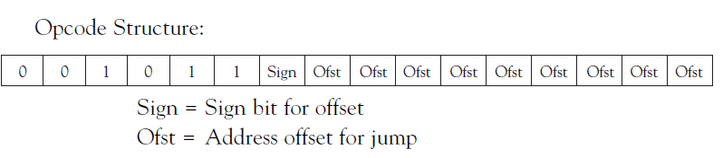
10. JC dest //Jump if carry
Description: A jump to the destination is made if the carry flag is set. The jump can be made up to 511 words backwards or 512 words forwards in the code.
Operation: if C=1, PC = PC+2*offset
Else, perform a NOP

Slide 101
Status Flags: Status flags are unaffected by this operation.
Example:
ADDC @R4,R7 ; Add the contents of the location pointed to by R4 to R7
JC FOO ; If carry flag is set by operation, jump to FOO
DADD.B R7,R8 ; add two decimals in R7 to R8
JC BAR ; If result >99, jump to BAR

Slide 102
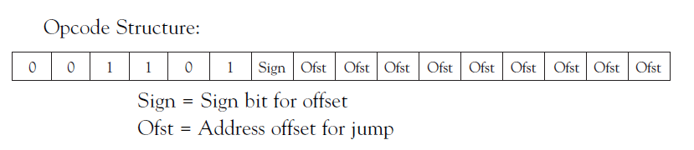
11. JGE dest //Jump if greater than or equal to
Description: A jump to the destination is made if the overflow flag and negative flag have the same value. The jump can be made up to 511 words backwards or 512 words forwards in the code.
Operation: if N.XOR.V=0, PC = PC+2*offset
Else, perform a NOP

Slide 103
Status Flags: Status flags are unaffected by this operation.
Examples:
CMP R4,R7 ; Compare R4 to R7
JGE FOO ; If R7>=R6, jump to FOO
CMP R5,#0FF00h ; Compare R5 to constant
JGE BAR ; If R5<constant, jump to BAR

Slide 104
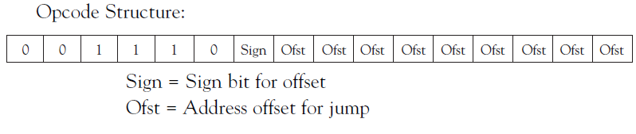
12. JL dest //Jump if less than
Description: A jump to the destination is made if the overflow flag and negative flag have complementary values. The jump can be made up to 511 words backwards or 512 words forwards in the code.
Operation: if N.XOR.V=1, PC = PC+2*offset
Else, perform a NOP

Slide 105
Status Flags: Status flags are unaffected by this operation.
Examples:
CMP R4,R7 ; Compare R4 to R7
JL FOO ; If R7<R6, jump to FOO
CMP R5,#0FF00h ; Compare R5 to constant
JL BAR ; If R5>=constant, jump to BAR

Slide 106
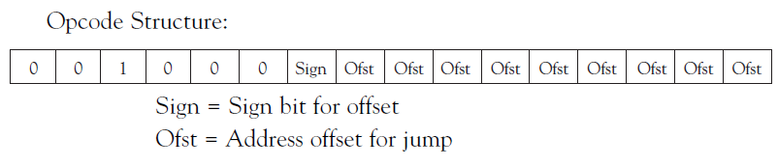
13. JMP dest //Unconditional jump
Description: A jump to the destination is made. The jump can be made up to 511 words backwards or 512 words forwards in the code.
Operation: PC = PC+2*offset
Examples:
JMP FOO ; Unconditional jump to FOO

Slide 107
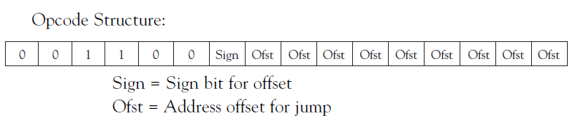
14. JN dest // Jump if negative
Description: A jump to the destination is made if the negative flag is set. The jump can be made up to 511 words backwards or 512 words forwards in the code.
Operation: if N=1, PC = PC+2*offset
Else, perform a NOP
Examples:
SUB R4,R7 ; Subtract R7 from R4
JN FOO ; If result is negative, jump to FOO

Slide 108
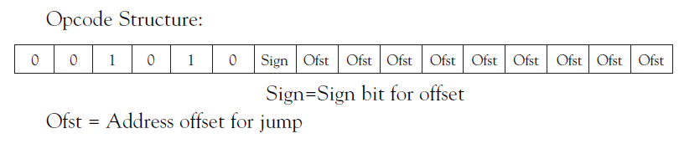
15. JNC dest //Jump if carry not set
Description: A jump to the destination is made if the carry flag is reset. The jump can be made up to 511 words backwards or 512 words forwards in the code.
Operation: if C=0, PC = PC+2*offset
Else, perform a NOP

Slide 109
Status Flags: Status flags are unaffected by this operation.
Example:
ADDC @R4,R7 ; Add the contents of the location pointed to by R4 to R7
JNC FOO ; If carry flag is not set by operation, jump to FOO
DADD.B R7,R8 ; add two decimals in R7 to R8
JNC BAR ; If result <99, jump to BAR

Slide 110
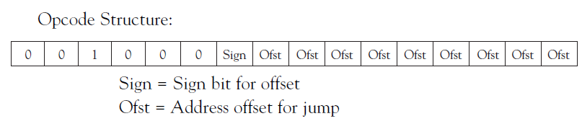
16. JNE or JNZ dest //Jump if not equal or jump if not zero
Description: A jump to the destination is made if the zero flag is reset. The jump can be made up to 511 words backwards or 512 words forwards in the code.
Operation: if Z=0, PC = PC+2*offset
Else, perform a NOP

Slide 111
Status Flags: Status flags are unaffected by this operation.
Example:
CMP R10,R11 ; Compare R10 to R11
JNE BAR ; If R10<>R11,jump to BAR
CMP R8,#0FF00h ; Compare R8 to constant
JNE FOO ; If R5<>constant, jump to FOO

Slide 112
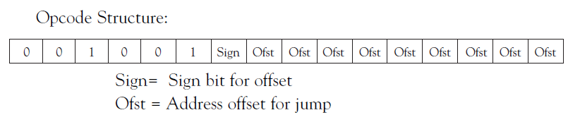
17. JZ or JEQ dest //Jump if Zero or Jump if equal
Description: A jump to the destination is made if the zero flag is set. The jump can be made up to 511 words backwards or 512 words forwards in the code.
Operation: if Z=1, PC = PC+2*offset
Else, perform a NOP

Slide 113
Status Flags: Status flags are unaffected by this operation.
Example:
MOV #5,R7 ; initialize counter
FOO ADD @R6+,R5 ; Accumulate next sample in R5
DEC R7 ; Check for last sample
JZ BAR ; If final sample, jump to label BAR
JMP FOO ; else, loop to FOO

Slide 114

18. MOV (.B or .W) src,dest //Move source to destination
Description: The source is copied to the destination. The value in source is preserved.
Operation: dest=src

Slide 115
Status Flags: Status flags are unaffected by this operation.
Example:
MOV #00FAh,R15 ; load constant into R15
MOV @R14+,R4 ; Move contents of address in R14 to R4, inc R14

Slide 116

19. PUSH (.B or .W) src //Push source to top of stack
Description: The stack pointer is decremented by two, and the source word is copied to the new TOS (top of stack) location.
Operation: SP=SP-2
@SP = src
Status Flags: Status flags are unaffected by this operation.
Example:
PUSH SR ; Status register is pushed to stack
PUSH R12 ; Push R12 to stack

Slide 117
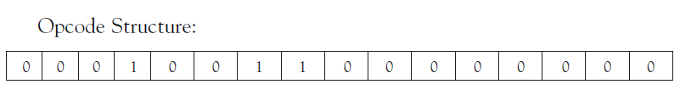
20 . RETI //Return from interrupt
Description: Returns program flow from ISR to previous address.
Operation: POP SR
POP PC
Status Flags: Status flags are restored from stack
Example:
RETI ; return from interrupt

Slide 118
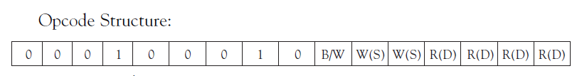
21. RRA (.B or .W) dest //Roll right arithmetically
Description: All bits in the destination are shifted right one bit location. The MSB is preserved, and the LSB is shifted into the carry flag.
Operation: dest (MSB) preserved
dest (MSB)=>dest(MSB-1)
:
:
dest (LSB+1)=>dest(LSB)
dest (LSB)=>C

Slide 119
Status Flags: Z: Set if result=0, reset otherwise
C: Loaded from LSB N: Set if result<0, reset otherwise
V: Reset
Example:
MOV #4,R7 ; initialize counter for divide by 32
FOO RRA R5 ; Divide R5 by 2
DEC R7 ; Check for last divide
JZ BAR ; If final sample, jump to label BAR
JMP FOO ; else, loop to FOO

Slide 120

22. RRC (.B or .W) dest //Roll right through carry
Description: All bits in the destination are shifted right one bit location. The carry flag is shifted into the MSB, and the LSB is shifted into the carry flag.
Operation: C=>dest (MSB)
dest (MSB)=>dest(MSB-1)
:
:
dest (LSB+1)=>dest(LSB)
dest (LSB)=>C

Slide 121
Status Flags: Z: Set if result=0, reset otherwise
C: Loaded from LSB
N: Set if result<0, reset otherwise
V: Set if dest>0 and C=1, reset otherwise
Example:
FOO RRC R6 ; This set of commands shifts
RRC R5 ; 64 bits of data through the
RRC R4 ; processor registers and into the
RRC &P1OUT ; Port 1 output register

Slide 122

23. SUB (.B or .W) src,dest //Subtract source from destination
Description: The source is subtracted from the destination. The value in source is preserved. This operation and the CMP operation affect flags identically.
Operation: dest = dest-src

Slide 123
Status Flags: Z: Set if result=0, reset otherwise
C: Set if dest+ NOT.src +1 produces a carry, reset otherwise
N: Set if src >= dest, reset otherwise
V: Set on arithmetic overflow
Example:
SUB #4,R12 ; Subtract 4 from R12
JN BAR ; If R12 was <4 prior to op, jump to BAR

Slide 124

24. SUBC (.B or .W) src,dest //Subtract source and borrow from destination
Description: The source and borrow are subtracted from the destination. The value in source is preserved. Borrow is defined as the complement of the carry flag. This operation and the CMP operation affect flags identically.
Operation: dest = dest-src – 1 + C

Slide 125
Status Flags: Z: Set if result=0, reset otherwise
C: Set if dest+ NOT.src +1 produces a carry, reset otherwise
N: Set if src >= dest, reset otherwise
V: Set on arithmetic overflow
Example:
SUBC #4,R12 ; Subtract 4 from R12
JN BAR ; If R12 was <4 prior to op, jump to BAR

Slide 126

25. SWPB dest //Swap Bytes
Description: The high byte and the low byte in the destination word are swapped.
Operation: temp=dest(high byte)
dest(high byte) = dest(low byte)
dest(low byte) = temp

Slide 127
Status Flags: Status flags are unaffected by this operation.
Example:
SWPB R12 ; Divide by 256 by swapping bytes
AND #00FFh,R12 ; and masking off top byte

Slide 128

26. SXT dest //Sign extend destination
Description: The sign of the low byte is copied into the high byte
Operation: dest(bits 8-15) = dest (bit 7)
Status Flags: Z: Set if result=0, reset otherwise
C: NOT Z
N: Set if result<0, reset otherwise
V: Reset
Example:
MOV.B &P2IN,R10; ; Load R10 with 8-bit value from Port 2
SXT R10 ; Sign extend for processing

Slide 129

27. XOR (.B or .W) src,dest //Logical XOR bits in source and destination
Description: The bits in the source operand are logically XORed with the bits in the destination operand, and the result is placed in the destination. The value in source is preserved.
Operation: dest = dest XOR src

Slide 130
Status Flags: Z: Set if result=0, reset otherwise
C: NOT Z
N: Takes value of result MSB
V: Set if both operands are negative
Examples:
XOR @R4,R7 ; XOR the contents of the location
pointed to by R4 to R7
XOR #00FFh,R12 ;Toggle the bits in the low byte of R12

Slide 131
Emulator
In computing, an emulator is hardware or software that enables one computer system (called the host) to behave like another computer system (called the guest).
An emulator typically enables the host system to run software or use peripheral devices designed for the guest system.
Emulation refers to the ability of a computer program in an electronic device to emulate (or imitate) another program or device.
Example : -
Many printers, are designed to emulate Hewlett-Packard LaserJet printers because so much software is written for HP printers. If a non-HP printer emulates an HP printer, any software written for a real HP printer will also run in the non-HP printer emulation and produce equivalent printing.

Slide 132
Emulated Instructions
1. BR dest //Branch to destination
Description: Unconditional branch operation to any location in memory.
Operation: PC = dest address
Emulation MOV dest , PC
Examples:
BR #FOO ; Branch to label FOO
BR R12 ; Branch to address contained in R12
BR @R12 ; Branch to address contained in word pointed to by R12

Slide 133
2. CLR (.B or .W) dest //Clear destination
Description: Destination is set to zero.
Operation: dest = 0
Emulation: MOV(.B or .W) #0,dest
Example:
CLR R11 ; Clears R11

Slide 134

3. CLRC //Clear carry flag
Description: Carry flag is reset.
Operation: C = 0
Emulation BIC #1,SR //status bit 1 is carry flag
Example:
CLRC ; Clears carry flag

Slide 135
4. CLRN //Clear negative flag
Description: Negative flag is reset.
Operation: N = 0
Emulation BIC #4,SR // status reg bit 4 is negative flag
Example:
CLRN ; Clears negative flag

Slide 136
5.CLRZ // Clear zero flag
Description: Zero flag is reset.
Operation: Z = 0
Emulation BIC #2,SR
Example:
CLRZ ; Clears zero flag

Slide 137
6. DADC (.B or .W) dest //Add carry decimally to destination
Description: The carry flag is added to the destination in decimal (BCD) format.
Operation: dest(BCD) = dest(BCD) + C
Emulation DADD(.B or .W) #0,dest
Example:
DADC.B R7,R8 ; add two decimals in R7 to R8
JC BAR ; If result >99, jump to BAR

Slide 138
7. DEC (.B or .W) dest //Decrement destination
Description: The destination is decremented by 1.
Operation: dest = dest-1
Emulation SUB(.B or .W) #1,dest
Example:
MOV #4,R7 ; //initialize counter for divide by 32
FOO RRA R5 ; //Divide R5 by 2
DEC R7 ; //Check for last divide
JZ BAR ; // If final sample, jump to label BAR
JMP FOO ; //else, loop to FOO

Slide 139
8. DECD (.B or .W) dest //Double decrement destination
Description: The destination is decremented by 2.
Operation: dest = dest-2
Emulation SUB(.B or .W) #2,dest
Example:
DECD BAR ; Decrement memory location BAR by 2

Slide 140
9. DINT Disable interrupts
Description: All interrupts are disabled.
Operation: GIE = 0
Emulation BIC #8,SR
Example:
DINT ; disables interrupts

Slide 141
10. EINT Enable interrupts
Description: All interrupts are enabled.
Operation: GIE = 1
Emulation BIS #8,SR
Example:
EINT ; enables interrupts

Slide 142
11. INC (.B or .W) dest //Increment destination
Description: The destination is incremented by 1.
Operation: dest = dest+1
Emulation ADD(.B or .W) #1,dest
Example:
MOV #0,R7 ; //initialize counter for R7
FOO ADD BASE(R7),R5 ; //Add new value to R5
INC R7 ; //increment counter
CMP #8,R7 ; //Check for last sample
JZ BAR ; // If final sample, jump to label BAR
JMP FOO ; //else, loop to FOO

Slide 143
12. INCD (.B or .W) dest Double //incrément destination
Description: The destination is incremented by 2.
Operation: dest = dest+2
Emulation Add(.B or .W) #2,dest
Example:
INCD BAR ; Decrement memory location BAR by 2
JC FOO ; Jump to FOO if carry

Slide 144
13. INV (.B or .W) dest //Invert destination
Description: The bits in destination are inverted.
Operation: dest = NOT.dest
Emulation XOR #0FFFFh,dest ; word operation
XOR #0FFh,dest ; byte operation
Example:
INV R6 ; inverts bits in R6

Slide 145
14. NOP //No operation
Description: No operation is performed. Typically, this instruction is used to fill time for code synchronization purposes.
Operation: None
Emulation MOV #0,R3

Slide 146
15. POP (.B or .W) dest //Pop stack to destination
Description: The value at TOS is moved to destination, and the stack
pointer is incremented accordingly.
Operation: dest = @SP, SP=SP+2
Emulation MOV(.B or .W) @SP+,dest
Example:
POP R6 ; restores R6 from stack
POP SR ; restores status register from stack

Slide 147
16. RET //Return from subroutine
Description: The complement of the CALL mnemonic, RET pops the PC address from the stack
Operation: PC = @SP, SP=SP+2
Emulation MOV @SP+,PC
Example:
RET ; returns from subroutine call

Slide 148
17. RLA (.B or .W) dest Roll left arithmetically
Description: All bits in the destination are shifted left one bit location. The LSB is reset, and the MSB is shifted into the carry flag.
Operation: dest (MSB)=>C
dest (MSB-1)=>dest(MSB)
:
:
dest (LSB)=>dest(LSB+1)
dest (LSB) = 0

Slide 149
Emulation ADD(.B or .W) dest,dest
Example:
MOV #4,R7 ; initialize counter for multiply by 32
FOO RLA R5 ; multiply R5 by 2
DEC R7 ; Check for last multiply
JZ BAR ; If final multiply,jump to BAR
JMP FOO

Slide 150
18. RLC (.B or .W) dest //Roll left through carry
Description: All bits in the destination are shifted left one bit location. The LSB is loaded with carry, and the MSB is shifted into the carry flag.
Operation: dest (MSB)=>C
dest (MSB-1)=>dest(MSB)
:
:
dest (LSB)=>dest(LSB+1)
dest (LSB) = C

Slide 151
Emulation ADDC(.B or .W) dest,dest
Example:
BAR RLC R15 ; This set of commands shifts
RLC R14 ; 64 bits of data through the
RLC R13 ; processor registers and into the
RLC &P4OUT ; Port 4 output register

Slide 152
19. SBC (.B or .W) dest //Subtract borrow from destination
Description: The borrow is subtracted from the destination. Borrow is defined as the complement of the carry flag.
Operation: dest = dest– 1 + C
Emulation SUBC (.B or .W) #0,dest
Example:
SBC R12 ; Subtract C from R12
JN BAR ; If R12 = 0 and C = 1, jump to BAR

Slide 153
20. SETC Set carry flag
Description: Carry flag is set.
Operation: C = 1
Emulation BIS #1,SR
Example:
SETC ; sets carry flag
21. SETN Set negative flag
Description: Negative flag is ret.
Operation: N = 1
Emulation BIS #4,SR
Example:
SETN ; sets negative flag

Slide 154
22. SETZ Set zero flag
Description: Zero flag is set.
Operation: Z = 1
Emulation BIS #2,SR
Example:
SETZ ; sets zero flag
23. TST (.B or .W) dest Test destination
Description: Destination is tested for a zero condition
Operation: dest-0
Emulation CMP (.B or .W) #0,dest
Example:
TST R12 ; tests R12
JZ BAR ; if R12=0, jump to BAR

Slide 155
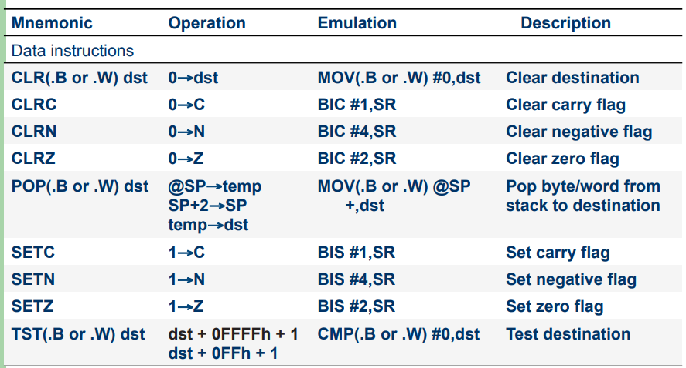

Slide 156
Constant Generator
One of the reasons for the high code efficiency of the MSP430 architecture is the constant generator.
The constants, appearing most often in assembler software, are small numbers.
Out of these, six were chosen for the constant generator:

Slide 157
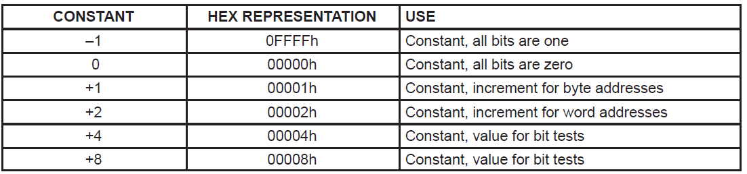
These six constants can also be used for byte processing. Only the lower byte is in use then.

Slide 158
The use of numbers out of the constant generator has two advantages:
Memory Space: The constant does not need an additional 16 bit word as it is the case with the normal immediate mode.
Two useless addressing modes of the status registers SR and all four addressing modes of the otherwise unserviceable register R3 are used.
Speed: The constant generator is implemented inside the CPU which results in an access time similar to a general purpose register (shortest access time).
Most of the emulated instructions use the constant generator.

Slide 159
Address Space
Mapped into a single, contiguous address space:
▪ Flash/ROM: All code, tables, and hard-coded constants reside in this memory space.
▪ Information memory: Variables needed for the next power up can be stored here during power down. It can also be used as code memory.
▪ Boot memory: The bootstrap loader performs some of the same functions as the JTAG interface.
▪ RAM: RAM is used for both code and data.
▪ Peripheral Modules: Peripheral modules consist of all on chip peripheral registers that are mapped into the address space.
▪ Special Function Registers (SFRs): Some peripheral functions are mapped into memory with special dedicated functions.

Slide 160
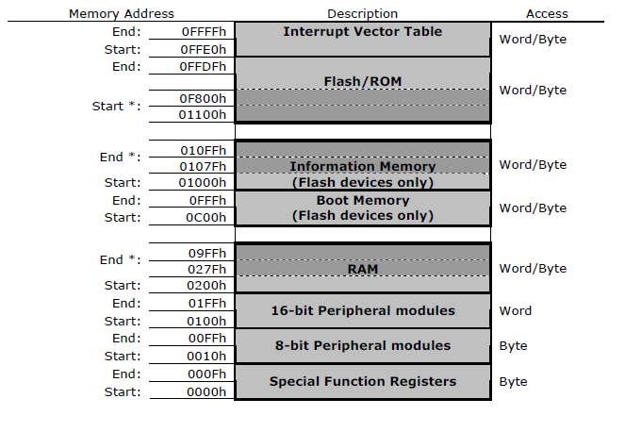
The additional memory, available for additional ROM.
The 64KB of memory laid out in exactly the same way as in the original MSP430.

Slide 161
The range of addresses has been extended from 64KB to 1MB in the MSP430X.
This means that addresses require 20 bits rather than 16 and the MAB is therefore 4 bits wider.

Slide 162
Resets
A reset is a sequence of operations that puts the device into a well-defined state, from which the user’s program may start.
This is obviously necessary when power is first applied.
A reset is also generated if the device detects a serious fault in hardware or software from which the user’s program cannot be expected to recover.
MSP 430 has 2 level of reset

Slide 163
Power-On Reset (POR)
Caused by hardware.
Response of hardware to brownout (low-power) condition.
Hard power-on is extreme case of brownout.
Can happen if physical RST pin is asserted.
Some MSP430s have a Supply Voltage Supervisor (SVS) that can
generate a power-on condition if supply voltage drops below acceptable
levels.
Power-Up Clear (PUC)
Distinctive from power-on reset.
Caused by software conditions.
Watchdog timer expiration.
Software-generated reset condition (bad Watchdog password).
Runaway Flash memory programming (bad Flash controller password).
Access violations (reading IC from peripheral registers…)

Slide 164
Conditions after reset
General effects:
RST/NMI pin configured as RST.
Most input/output pins configured as inputs:
Software should configure unused pins as outputs (or otherwise ensure unused
inputs are not floating).
Peripheral registers set the way the datasheet says:
rw-0 notation means: readable/writeable and initialized to 0 on PUC.
rw-(0) notation means: readable/writeable and initialized to 0 only on POR.
Status register is cleared (brought out of low-power mode if necessary).
Watchdog timer is enabled:
Software should explicitly disable if not used.
Program counter (R0) is loaded with the reset vector.

Slide 165
What caused the reset?
Can be determined through the IFG1 and perhaps other flag registers.
The following bits will be set to identify the source of the reset:
WDTIFG: Watchdog caused reset.
OFIFG: Oscillator fault (non-maskable interrupt actually, not a reset).
RSTIFG: RST pin was asserted.
PORIFG: Set on power-on reset (POR).
NMIIFG: NMI pin was asserted (non-maskable interrupt actually, not a reset).
On PUC: The WDTIFG bit is not cleared—so the source of the PUC can be determined.
Other flags for Flash security and the supply voltage supervisor (if applicable) exist
elsewhere (see datasheets).
Doesn’t appear to be a flag for an illegal opcode!

Slide 166
Watchdog Timer
MSP430 Watchdog
Must be periodically reset by software to keep the timer from expiring and
resetting the system.
Virtually all uC systems have Watchdog timers. The details of how to do a
“software check-in” vary from one system to another.
In the MSP430, the WDTCNTCL bit in the WDTCTL register must be written as a 1
before the timer expires.
The upper 8 bits must be 0x5A (WDTPW).
In the MSP430, setting the WDTHOLD bit in the WDTCTL register suspends the
Watchdog timer.
MSP430 Watchdog can be clocked from SMCLK or ACLK.
Clock source can be scaled down before entering the counter.

Slide 167
Watchdog Timer
MSP430 Watchdog
In the MSP430, can alternatively be configured as an interval timer.
Set the WDTTMSEL bit in the WDTCTL to configure it as a timer.
When it expires, no reset occurs and the usual reset vector is not acknowledged.
An alternate vector is consulted when the timer overflows (if and only if the maskable
interrupts are enabled).
Using interrupts or not, a flag is raised.
If using interrupts, the hardware will automatically clear this flag
(to save software the trouble).
If no interrupts, software must poll and clear this flag manually.

Slide 168
CLOCK SYSTEM
The basic clock module includes:
One digital controlled oscillator (DCO) with RC-type characteristics
One crystal oscillator used for low-frequency crystals (watch crystals,
e.g., 32,768 Hz) or for crystals in the range of 450 kHz to 8 MHz.
One optional crystal oscillator for crystals in the range of 450 kHz to 8 MHz.

Slide 169
The basic clock module supplies the MSP430 with three clock signals:
ACLK, crystal oscillator signal
MCLK, controllers main system clock
SMCLK, sub main system clock used to run the peripheral module function
The three clock signals come from three clock sources:
DCO clock (DCOCLK)
low/high frequency oscillators clock (LFXT1CLK) high frequency oscillator (XT2CLK, optional).
The selected clock frequencies can be divided by 1, 2, 4, or 8. The division rate is software selectable.

Slide 170
Defaults
The CPU (MCLK) is driven by a digitally controlled oscillator (DCO) at a frequency of about 1 MHz.
The sub-system master clock (SMCLK) is also driven by DCO at ~1 MHz.
ACLK comes from a low-frequency, external oscillator if present.
Features:
Varity of operating modes, driven by application requirements and be software selectable.
Support of a burst mode, that when activated, rapidly starts and stops the entire system (in active mode)
Sufficient stabilization of voltage, temperature, and time including a highly stable time base for real-time clocks.

Slide 171
Current-limited real-time applications have two conflicting requirements:
Low system clock frequency for energy conservation
High system clock frequency for fast reactions to event requests.
The different requirements of the CPU and associated modules, driven by system cost and current consumption objectives, lead to the use of three clock signals.
Auxiliary Clock (ACLK), with LF crystals frequency
Main System Clock (MCLK), used by the CPU and system
Sub–System Clock (SMCLK), used by the peripheral modules.
The implementation of the basic clock module into MSP430 devices can have two or three oscillators.

Slide 172
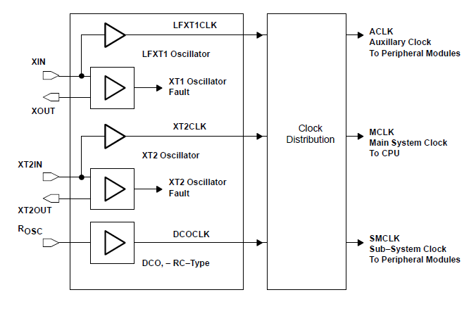
Basic clock module with 3 oscillators

Slide 173
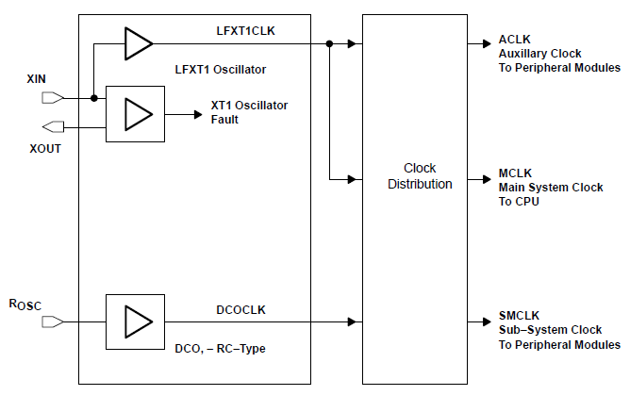
Basic Clock Module with 2 Oscillators

Slide 174
The clock distribution system selects a clock source, individually, for each of the three clock outputs:
One clock source for the CPU clock; MCLK signal
Two clock sources for the peripheral module clocks; SMCLK and ACLK
The auxiliary clock (ACLK) is the buffered output of the LFXT1 oscillator and provides clock signals for peripheral modules.
The control bit XTS selects whether the LFXT1 oscillator operates as a low-frequency (LF) crystal oscillator or as a high-frequency (XT1) oscillator.

Slide 175
The source of the main system clock (MCLK) is determined by which clock is selected.
LFXT1CLK
XT2CLK
DCOCLK
The control bit DIVM determines the division of the clock source, 1, 2, 4, or 8.
The CPUOff bit is located in the status register and halts the selected clock source.
The source of the subsystem clock (SMCLK) is:
XT2CLK (or LFXT1CLK with the two oscillator implementation)
DCOCLK.
The control bit DIVS selects how the clock source is divided, 1, 2, 4, or 8.
The SCG1 bit is located in the status register and halts the selected clock source.

Slide 176
Low Power Modes
The MSP430 MCU utilizes six different Low-Power Modes, which can disable unused clocks and CPU.
This allows the MSP430 to sleep, while its peripherals continue to work without the need for an energy to processor.
Additionally, the MSP430 is capable of wake-up times below 1 microsecond, allowing the microcontroller to stay in sleep mode longer, minimizing its average current consumption.

Slide 177
With the multiple low power modes, there is a notable difference in the amount of power consumed between MSP430 and other microcontrollers.
MSP430 uses up to 70% less power than the PIC24F16KA102 in active mode.
In standby mode, the PIC24F16KA102 consumes up to 41% and STM8L151G4 consumes up to 9 times more power than the MSP430.
Multiple low power modes, with flexible clocking system, instant wakeup, and intelligent autonomous peripherals enable true ULP optimization, dramatically extending battery life.

Slide 178
Flexible Clocking System
The MSP430 MCU clock system has the ability to enable and disable various clocks and oscillators which allow the device to enter various low-power modes (LPMs).
The flexible clocking system optimizes overall current consumption by only enabling the required clocks when appropriate.

Slide 179
Contd..
Main Clock (MCLK) : CPU source that may be driven by the internal Digitally Controlled Oscillator (DCO) up to 25 MHz or with external crystal.
Auxiliary Clock (ACLK) : Source for individual peripheral modules driven by the internal low-power oscillator or external crystal
Sub-Main Clock (SMCLK) : Source for faster individual peripheral modules that may be driven by the internal DCO up to 25 MHz or with external crystal

Slide 180
Power modes
Active Mode : Nothing is turned off (except maybe individual peripheral modules). No power savings.
LPM0 :CPU and MCLK are disabled while SMCLK and ACLK remain active.
LPM1 : CPU and MCLK are disabled, and DCO and DC generator are disabled if the DCO is not used for SMCLK. ACLK is active.

Slide 181
Contd..
LPM2 : CPU, MCLK, SMCLK, DCO are enabled DC generator remains enabled. ACLK is active
LPM3 :CPU, MCLK, SMCLK, DCO are disabled, DC generator is disabled, ACLK is active
LPM4:CPU is disabled, ACLK is disabled, MCLK and SMCLK are disabled DCO’s dc-generator is disabled Crystal oscillator is stopped

Slide 182
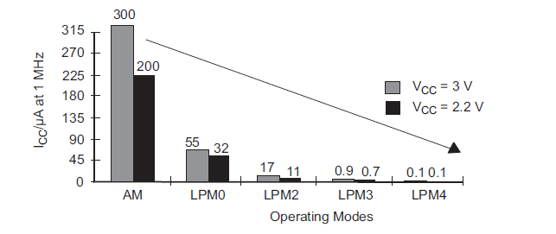
It is important to note that the parts of the microcontroller that are shut off, will not operate until they are turned on again by interrupts.

Slide 183
LOW POWER MODES OF MSP 430
The MSP430 MCU utilizes six different Low-Power Modes, which can disable unused clocks and CPU.
This allows the MSP430 to sleep, while its peripherals continue to work without the need for an energy hungry processor.
Additionally, the MSP430 is capable of wake-up times below 1µs, allowing the microcontroller to stay in sleep mode longer, minimizing its average current consumption.
The low power modes can be switched by programming the status register.
In addition to the low power modes MSP 430 can also program two other low power modes as LPM 3.5 and LPM 4.5.
These LPM 3.5 and LPM 4.5 are present in microcontrollers which consists the inbuilt voltage regulator.

Slide 184
Low Power Modes
BOR
Brown Out Reset
take the CPU from Reset to Actively running
POR
PUC
Active Mode
LPM0
LPM4
LPM1
LPM3
LPM2
changing these modes is simply done by changing a couple of bits in the Status Register.)

Slide 185
Power modes
Active Mode : CPU, all clocks, and enabled modules are active, I <= 300µA.
The MSP430 starts up in this mode.
An interrupt automatically switches the device to active mode.
Nothing is turned off (except maybe individual peripheral modules). No power savings.
LPM0 : CPU and MCLK are disabled while SMCLK and ACLK remain active, I<=85µA. DCO in active.
LPM1 : CPU and MCLK are disabled, and DCO and DC generator are disabled if the DCO is not used for SMCLK. ACLK is active.

Slide 186
LPM2 : CPU, MCLK, SMCLK, DCO are disabled, DC generator remains enabled. ACLK is active
LPM3 : CPU, MCLK, SMCLK, DCO are disabled, DC generator is disabled, only ACLK is active, I<=1µA.
LPM4 : CPU is disabled, ACLK is disabled, MCLK and SMCLK are disabled DCO’s & dc-generator is disabled Crystal oscillator is stopped, I<=0.1µA. This is also called RAM retention mode.

Slide 187
It is important to note that the parts of the microcontroller that are shut off, will not operate until they are turned on again by “interrupts”.

Slide 188
Low Power Modes
BOR
POR
PUC
Active Mode
LPM4.5
LPM0
LPM4
LPM1
LPM3
LPM3.5
LPM2
Notes:
These modes also turn off the processor core’s internal voltage regulator, in addition to the low-power tricks applied by LPM3 or 4, thus saving even more energy.
Of course, these modes are only available on the devices that contain an on-chip voltage regulator. (You might remember we discussed these back in the chapter on clocking and power management.)
The main difference with these modes – that is, beyond being the lowest power states on the MSP430 – is that because the voltage regulator is turned off, exiting them results in a brownout reset (BOR). If you’re using these modes, you will want your boot routine to check if you’re restarting the CPU from a dot-5 (.5) mode.
So… what actually gets turned off in each low-power mode?

Slide 189
These modes also turn off the processor core’s internal voltage regulator, in addition to the low-power tricks applied by LPM3 or 4, thus saving even more energy.
Of course, these modes are only available on the devices that contain an on-chip voltage regulator.
The main difference with these modes – that is, beyond being the lowest power states on the MSP430 – is that because the voltage regulator is turned off, exiting them results in a brownout reset (BOR).

Slide 190
Low-Power Modes
Operating Mode | CPU (MCLK) | SMCLK | ACLK | RAM Retention |  |  | Interrupt Sources
Active |  |  |  |  |  |  | Timers, ADC, DMA, WDT, I/0, External Interrupt, COMP, Serial, RTC, other…
LPM0 |  |  |  | 
LPM1 |  |  |  | 
LPM2 |  |  |  | 
LPM3 |  |  |  | 
LPM4 |  |  |  |  |  |  | External Interrupt
Notes:
This table shows what features are active in each of the low-power modes.
As we work down from Active Mode, we see that each of the MSP430 internal clocks get turned off at different levels.
For example, MCLK (the CPU clock) gets disabled right away at LPM0… but the low-frequency ACLK stays on through LPM3. Turning off each of these clocks saves power.
There are three other things to notice on this slide:
The RAM is powered in every state… except the two dot-5 modes where the voltage regulator is disabled. (BTW, some later devices let you disable all – or individual banks of RAM – in addition to these modes.)
The BOR (i.e. brownout reset) peripheral is ALWAYS on… which is a good thing.
Finally, the table shows that the MSP430 can wake itself up in all but the LPM4 modes. This relates to the adjacent “Interrupt Sources” column. Except for LPM4 and 4.5, there can be internal peripherals running which can be used to “wake” the CPU up from a low-power mode; these modes rely on some external event to wake them from sleep.
As a final note, many low-power enthusiasts really value TI’s FRAM-based processors because FRAM can be used like traditional RAM, but doesn’t loose its contents – even in LPM3.5 or 4.5 modes. In fact, for many users, FRAM has actually made these lowest-power states usable (as opposed to a pretty spec on the datasheet).

Slide 191
Low-Power Modes (Bit Settings)
Operating Mode | CPU (MCLK) | SMCLK | ACLK | Vcore | RAM Retention | FRAM Retention | Status Register (SR)
 |  |  |  |  |  |  | CPUOFF | OSCOFF | SCG0 | SCG1
Active |  |  |  |  |  |  | 0 | 0 | 0 | 0
LPM0 |  |  |  |  |  |  | 1 | 0 | 0 | 0
LPM1 |  |  |  |  |  |  | 1 | 0 | 1 | 0
LPM2 |  |  |  |  |  |  | 1 | 0 | 0 | 1
LPM3 |  |  |  |  |  |  | 1 | 0 | 1 | 1
LPM3.5 |  |  |  |  |  |  | 1 | 1 | 1 | 1
LPM4 |  |  |  |  |  |  | 1 | 1 | 1 | 1
LPM4.5 |  |  |  |  |  |  | 1 | 1 | 1 | 1
* SCG = System Clock Generator
Notes:
This slide extends the previous “Low-Power Modes” slide by adding 3 items:
We’ve added a column to show where the core’s voltage regulator (Vcore) is running. As you might expect, it’s turned off in LPM3.5 and LPM4.5 (along with the RAM).
As we mentioned in the final note to the last slide, FRAM always retains its contents regardless of power or LPM state.
Finally, we’ve added the configuration bits that correlate to each Low-Power Mode; most of them are found in the Status Register (SR) – except the bit that turns off the core’s voltage regulation.

Slide 192
Entering Low Power Modes
Enter LPMx | C Compiler Intrinsic
LPM0 | _low_power_mode_0();
LPM1 | _low_power_mode_1();
LPM2 | _low_power_mode_2();
LPM3 | _low_power_mode_3();
LPM4 | _low_power_mode_4();
Notes:
Using the TI C compiler, the easiest way to enter a low-power mode is to call its associated intrinsic function.

Slide 193
Entering Low Power Modes
Enter LPMx | C Compiler Intrinsic | Writing to SR with Intrinsic
LPM0 | _low_power_mode_0(); | _bis_SR_register( GIE + LPM0_bits );
LPM1 | _low_power_mode_1(); | _bis_SR_register( GIE + LPM1_bits );
LPM2 | _low_power_mode_2(); | _bis_SR_register( GIE + LPM2_bits );
LPM3 | _low_power_mode_3(); | _bis_SR_register( GIE + LPM3_bits );
LPM4 | _low_power_mode_4(); | _bis_SR_register( GIE + LPM4_bits );
As written, both intrinsic functions enable interrupts and the associated low-power mode
bis (and bic) instructions mimic assembly language:
bis = bit set
bic = bit clear
bis/bic intrisics allows greater flexibility in selecting bits to set/clear
Notes:
Alternatively, you enter a low-power mode by writing directly to the Status Register.
This involves using the “bit set” Status Register intrinsic. In the example shown here, for LPM0 we’re setting to the Global Interrupt Enable bit, as well as the LPM0 bits in the Status Register.
Both methods shown here will achieve the same goal of entering a low-power mode with interrupts enabled. The low-power-mode function is a bit easier to read, although the SR function provides slightly more flexibility. Nice thing is that you can choose whichever suits you.
But wait … once you enter a low-power mode, you can automatically reenter it without having to call the function again! Let’s turn to the next slide to explain this further…

Slide 194
Automatically Re-entering LPM (after ISR)
main()
{
initGpio();
initClocks();
initTimers();
_low_power_mode_3();
while(1);
}
Executing LPM3 function puts the processor standby
Unless an interrupt occurs, CPU will stay asleep
LPM3
Notes:
As we see in this example, once we place the CPU into a low-power mode – such as LPM3 – it will stay there forever … that is, until an interrupt occurs.
When an interrupt wakes the CPU…

Slide 195
Automatically Re-entering LPM (after ISR)
main()
{
initGpio();
initClocks();
initTimers();
_low_power_mode_3();
//while(1);
}
#pragma vector = TIMER1_A0
__interrupt ISR()
{
GPIO_toggleOutputOnPin()
} // Return from interrupt (RETI)
Executing LPM3 function puts the processor standby
Unless an interrupt occurs, CPU will stay asleep
No while{} loop is needed
LPM3
An interrupt wakes the CPU
Status Register (SR) is saved to stack (including the LPM setting)
Exiting ISR routine:
Compiler uses RETI instruction which restores SR from stack
Restoring SR places CPU back into low-power mode
Notes:
…the processor leaves the low-power mode and enters an interrupt service routine.
In the ISR, the MSP430 automatically saves the Status Register (SR) and program counter, and then returns to Active Mode, turning on whichever clocks where shut down by the low-power mode. It then executes the appropriate Interrupt Service Routine.
Wait, what happened as the CPU returned to Active Mode? It automatically saved the Status Register by pushing it to the stack. And why do we care about that here in the Low-Power chapter? Well, if you remember from a few slides ago, the bits that put the processor into low-power mode are located in the Status Register. This means that as we enter the ISR, we’re actually saving the operating mode the processor resided in before the interrupt. (A fact that will be very important in just a minute.)
At the end of the ISR, the compiler calls the Return From Interrupt (RETI) assembly language instruction. This not only restores the Program Counter – putting us back to whatever code we were running before the interrupt – but it also restores the Status Register.
Wow, that means our device automatically goes right back into Low-Power Mode without us having to do anything.
In fact, in this example, we don’t even need the while{} loop. As written, once the CPU enters LPM3, it will stay there except for when it’s servicing an interrupt. As we said before, LOW POWER is in our DNA!
OK, that’s great an all… but what happens if I want to come out of a low-power mode and return to my main routine after an interrupt? I mean, you said in the interrupt chapter that we shouldn’t do a lot of heavy-duty processing in an ISR, so how can I get back to main() to perform my follow-up processing?

Slide 196
Leaving LPM (after ISR)
Executing LPM3 function puts the processor standby
Unless an interrupt occurs, CPU will stay asleep
Since ISR exits from LPM, we need additional code (such as a while{} loop)
main()
{
initGpio();
initClocks();
initTimers();
while(1){
_low_power_mode_3();
filter();
}
}
#pragma vector = TIMER1_A0
__interrupt ISR()
{
getSample();
_low_power_mode_off_on_exit();
} // Return from interrupt (RETI)
LPM3
An interrupt wakes the CPU
Status Register (SR) is saved to stack (including LPM bits)
Exiting ISR routine:
‘exit’ fcn modifies saved SR (clearing LPM) before restore
RETI instruction restores SR from stack
With LPM “off”, CPU returns to instruction after LPM intrinsic; e.g. filter()
Notes:
Here’s an example that shows us how to get back to our main code (and leave a low-power mode) after an interrupt. In this case, it looks like we want to run a filter algorithm after the ISR, then re-enter LPM3.
The key to leaving LPM after an interrupt is to call the “low_power_mode_off_on_exit” function somewhere in the ISR. This will disable the feature that automatically returns you to LPM.
In this example, since we called the “LPM off on exit” function, the compiler clears the low-power mode bits when Returning from Interrupt is called. As you might expect, this means our CPU starts executing whatever code follows the LPM3 function … which, in this case, is a filter() function.
But after that, the program counter returns to the top of the while loop and we enter LPM3 again … until the next time an interrupt occurs.
There you have it – you can either reenter LPM automatically …. or not.

Slide 197
Interrupts
MSP430 Interrupt structure working Sources of interrupts are I/O, Timers, reset and external interrupts.
Interrupt priorities

Slide 198
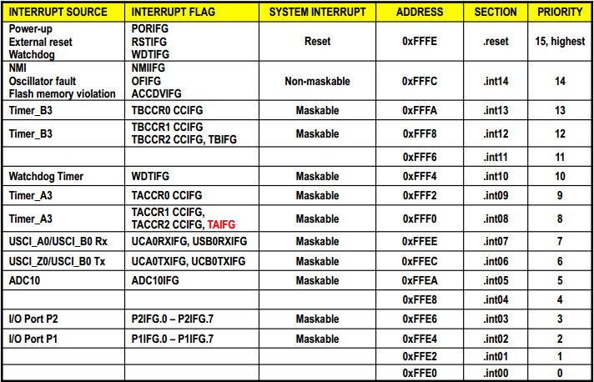
Interrupt vector Table
11

